Slide 1



Problem Statement Data Analytics to provide complete solution for groundwater management in the country
Ministry/Organisation name
CENTRAL GROUND WATER BOARD, MINISTRY OF JAL SHAKTI
Team Name : DataTech
Team Leader : Lal Babu Sah

Slide 2
BACKGROUND
The UNESCO World Water Development Report states that India is the largest extractor of groundwater in the world. Unfortunately, the groundwater levels in India has dropped drastically due to its overexploitation and contamination.
Groundwater supports livelihoods of over 26 crore farmers and agricultural labourers. It accounts for 63% of all irrigation water and over 80% of rural and urban domestic water supplies. Wells including dug wells and shallow tube- wells and deep tube wells provide about 61.6% of water for irrigation, followed by canals with 24.5%.
21 major cities of India are expected to run out of groundwater as soon as 2020, affecting around 100 million people, the think tank’s new report states.

Slide 3
SOLUTION
Identified blocks/districts/states with critical/average/increased groundwater levels in the country.
Analyzed Pre-monsoon and post-monsoon groundwater levels in 2017 with respect to previous year i.e. 2016
Analyzed pre-monsoon and post-monsoon groundwater levels in 2017 with decadal mean (2007-2016)
Time series analysis of groundwater level from 1996 to 2018 for pre-monsoon and post-monsoon duration (using ARIMA [Autoregressive Integrated Moving Average] model and BI tool - Tableau)
Percentage increase and decrease in the groundwater level at various sites(bore well, dug well and tube well)

Slide 4
TECHNOLOGY STACK
Data Acquisition : Python code to download data from the website of CGWA- IndiaWRIS
Data Preprocessing: Python (Libraries-Pandas, NumPy, Seaborn) on Jupyter notebook platform
Data Model: ARIMA model (time series depiction of groundwater levels in a region)
Data Visualization and Analysis: Business Intelligence tool –TABLEAU

Slide 5
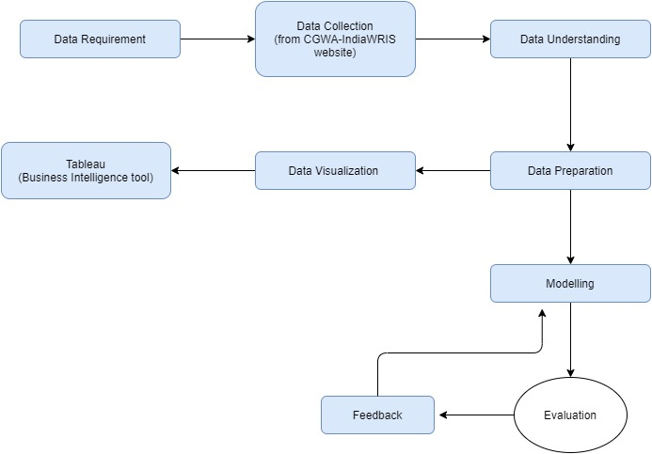
PROCESS FLOW FOR DATA ANALYTICS OF GROUNDWATER LEVELS

Slide 6
USED CASES
The areas under critical condition can be identified.
The concerned authorities can now take necessary measures to tackle the issue in these areas.
The areas which are on the verge of getting hit by groundwater shortage can take up precautionary measures to restore these resources.
The solution provided will aid the government in formulating ideas and strategies to help people in groundwater depreciating regions.
Flexibility of ARIMA model will enable us to forecast groundwater level trends.

Slide 7
DEPENDENCIES/SHOW STOPPER
Detailed and effective representation of data through maps (on Tableau – a Business Intelligence tool)
In depth analysis of changing trends over the years.
Identification of areas with scarcity of groundwater.
The analysis will help further in building of groundwater management strategies to save these areas.
Prospect: Culminating the results of the analysis under a platform (website) for making it more comprehensible.

Slide 8
THANK YOU !

